Slide 1

Molecular Nanographene as Quantum Units
Fanmiao Kong
21/06/2022

Slide 2
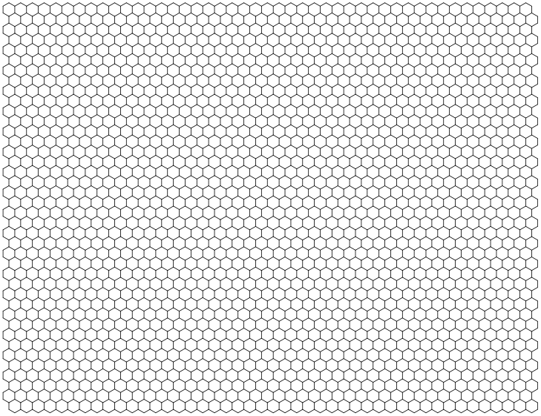
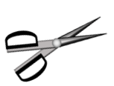
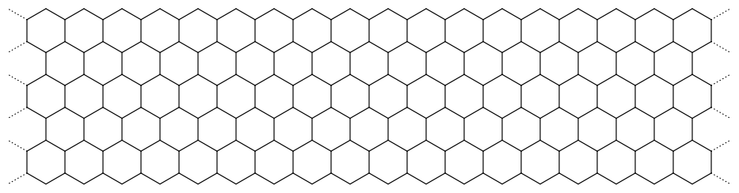
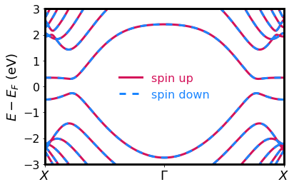
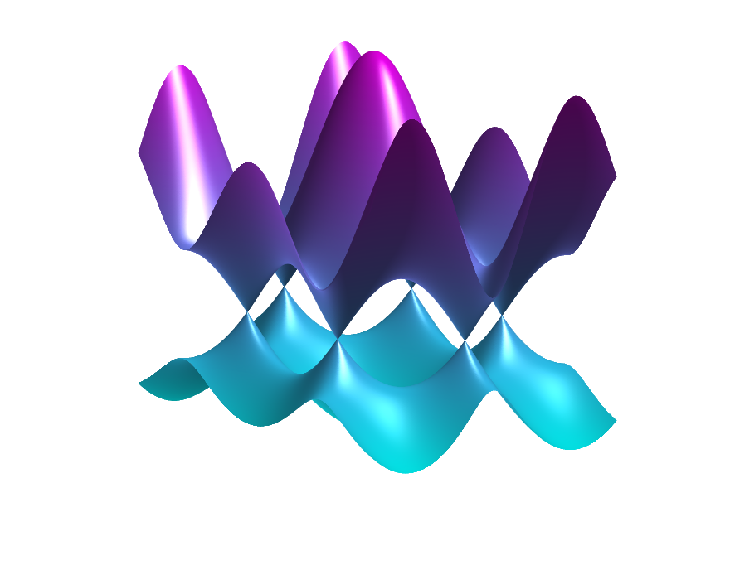
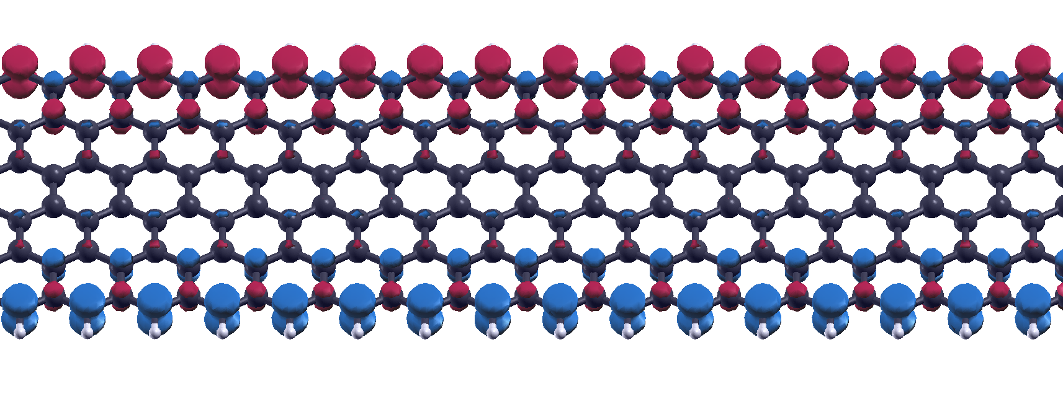
Magnetic Zigzag Edge States in Graphene Nanoribbon
2D graphene
1D zigzag graphene nanoribbon
“Cutting”
Band structure
Spin up
Gapless
Spin down
Band gap
Band structure
Spin-polarized zigzag edge states
1

Slide 3
Magnetic Zigzag Edge States in Graphene Nanoribbon
P Useful for spintronic devices
P Predicted to have long spin coherence time
J. Fischer, B. Trauzettel, D. Loss, Physical Review B 80, 155401 (2009).
O Synthesized in high vacuum. Chemically unstable
O Difficult to study the spin states
P. Ruffieux et al., Nature 531, 489 (2016)
2

Slide 4
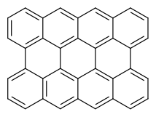
Zigzag Edge in Nanographene Molecule
1D zigzag graphene nanoribbon
0D nanographene molecule
3
Notes:
Further decrease the dimension.
Instead of study the extended structure, we study the small molecule, which still have a zigzag element

Slide 5
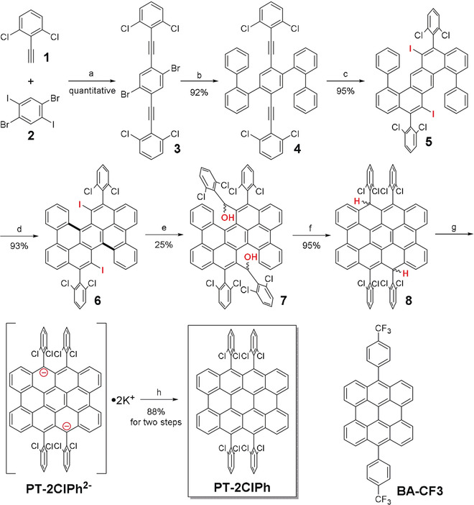
Zigzag Edge in Nanographene Molecule
1D zigzag graphene nanoribbon
Synthesized by Jishan Wu’s group at NUS
0D nanographene molecule
Y. Ni et al., Angewandte Chemie 130, 9845-9849 (2018)
3
Notes:
Further decrease the dimension.
Instead of study the extended structure, we study the small molecule, which still have a zigzag element

Slide 6
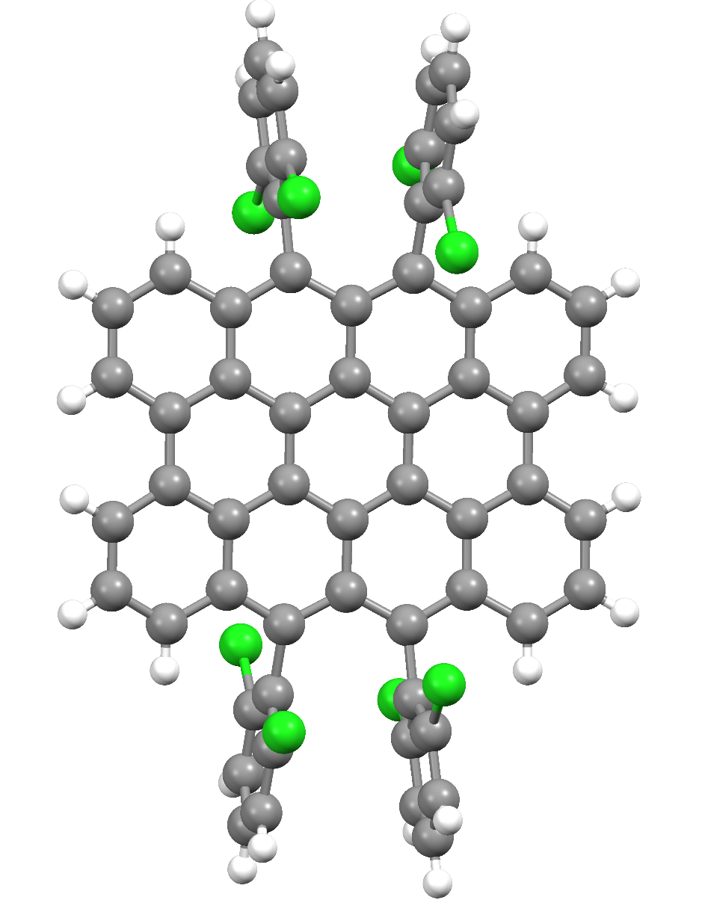
Zigzag Edge in Nanographene Molecule
Synthesized by Jishan Wu’s group at NUS
Bulky group to enhance stability and solubility
Peri-tetracene
Y. Ni et al., Angewandte Chemie 130, 9845-9849 (2018)
3

Slide 7
Zigzag Edge in Nanographene Molecule
Synthesized by Jishan Wu’s group at NUS
Bulky group to enhance stability and solubility
Does zigzag edge spin state still exist?
Peri-tetracene
Y. Ni et al., Angewandte Chemie 130, 9845-9849 (2018)
3

Slide 8
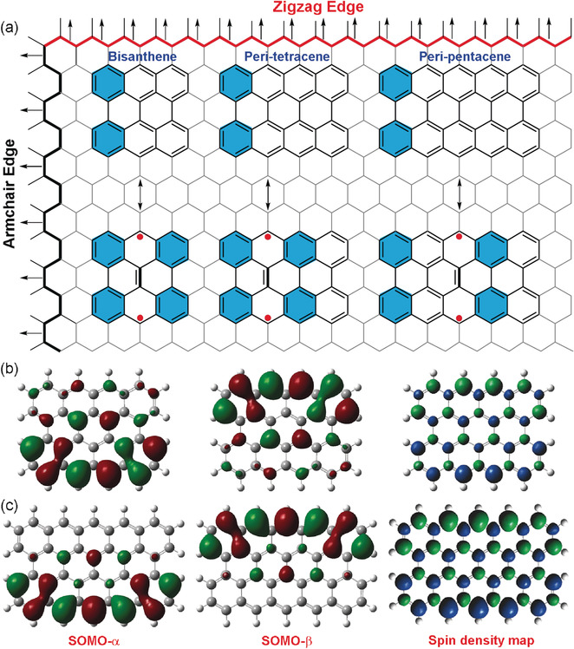
Peri-tetracene
Clar’s sextet rule:
More aromatic rings
→ More stable
52.5% diradical character
Peri-tetracene
Y. Ni et al., Angewandte Chemie 130, 9845-9849 (2018)
4

Slide 9
Peri-tetracene
Clar’s sextet rule:
More aromatic rings
→ More stable
52.5% diradical character
triplet
108.4 meV
Thermally accessible
singlet
Peri-tetracene
Y. Ni et al., Angewandte Chemie 130, 9845-9849 (2018)
4

Slide 10
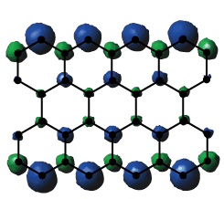
Peri-tetracene
Spin up
Spin down
Spin density of triplet state
5

Slide 11
Zigzag Edge in Extended Structures
6
Notes:
They all have edge states around Fermi level. Some can be spin-polarized
No Dirac cone, not even 1D band structure, but the spin-polarized zigzag edge states are preserved in this small molecule

Slide 12
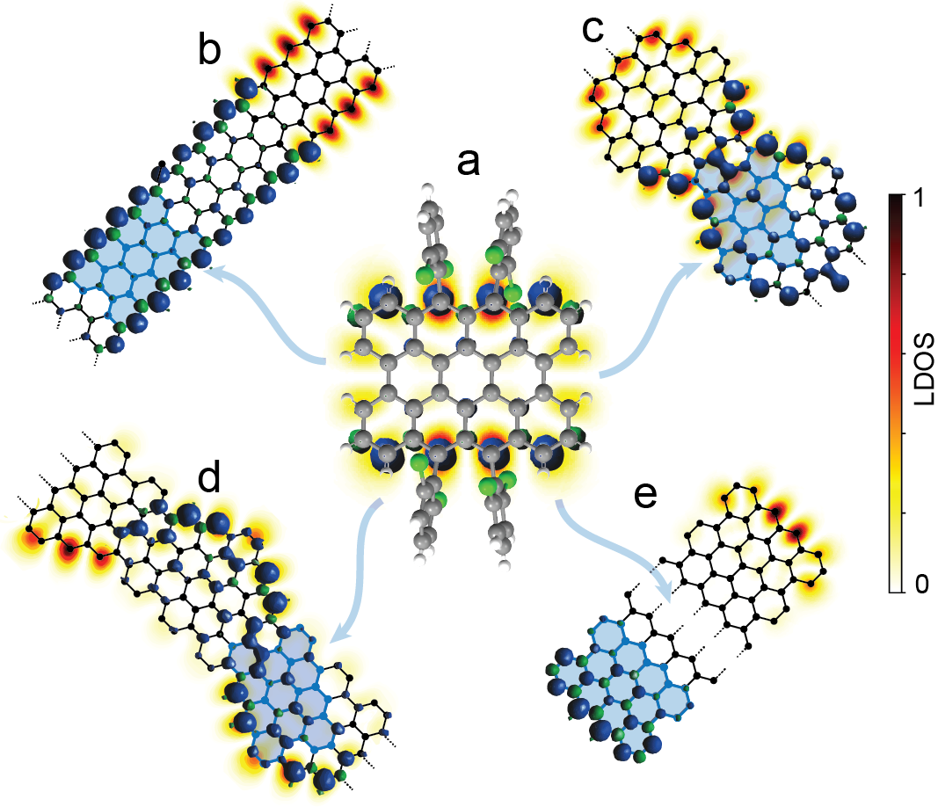
Zigzag Edge in Extended Structures
Spin-polarized states in zigzag edge
Local Density of States (LDOS) calculated by tight binding model
6
Notes:
They all have edge states around Fermi level. Some can be spin-polarized
No Dirac cone, not even 1D band structure, but the spin-polarized zigzag edge states are preserved in this small molecule

Slide 13
Zigzag Edge in Extended Structures
Topological phase
Spin-polarized states in zigzag edge
Quantum spin chain
Local Density of States (LDOS) calculated by tight binding model
6
Notes:
They all have edge states around Fermi level. Some can be spin-polarized
No Dirac cone, not even 1D band structure, but the spin-polarized zigzag edge states are preserved in this small molecule

Slide 14
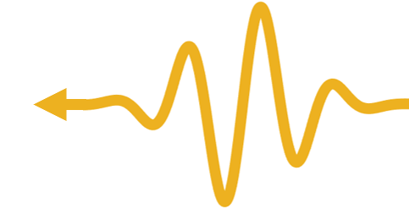
CW EPR Spectrum of Peri-tetracene
CW EPR:
Continuous Wave Electron Paramagnetic Resonance
Microwave
Energy
m_{S} = +1
S = 1
m_{S} = 0
S = 0
m_{S} = +1
Magnetic field
7

Slide 15
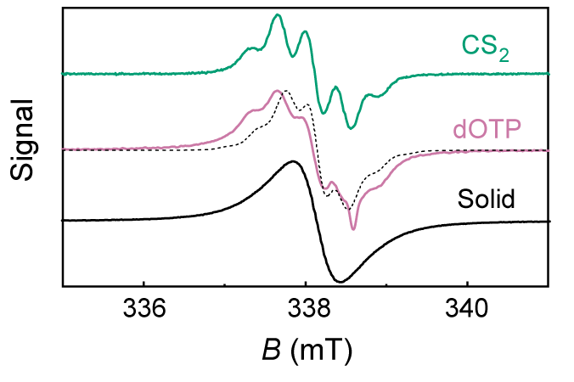
CW EPR Spectrum of Peri-tetracene
CW EPR:
Continuous Wave Electron Paramagnetic Resonance
Microwave
Energy
m_{S} = +1
S = 1
m_{S} = 0
S = 0
m_{S} = +1
Magnetic field
7

Slide 16
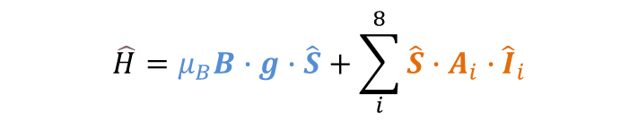
CW EPR Spectrum of Peri-tetracene
CW EPR:
Continuous Wave Electron Paramagnetic Resonance
Microwave
Energy
m_{S} = +1
S = 1
m_{S} = 0
S = 0
m_{S} = +1
Magnetic field
Hamiltonian to describe the system:
$$\hat{H}=μ_{B}B∙g∙\hat{S}+\sum_{i}^{8}{\hat{S}∙A_{i}∙{\hat{I}}_{i}}$$
Zeeman energy
Hyperfine interaction
7

Slide 17
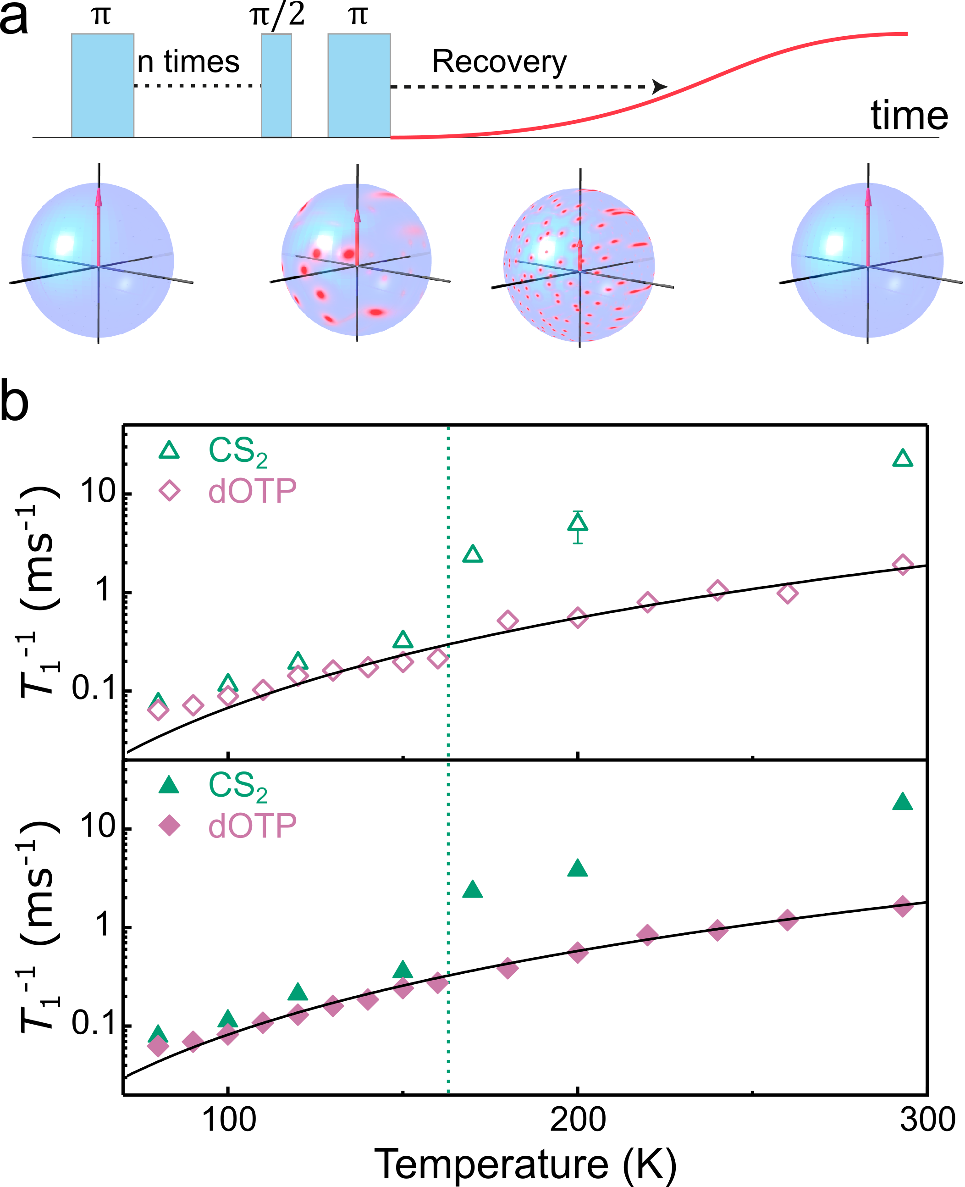
Pulsed EPR Study: Spin-Lattice Relaxation
Echo intensity
Measure T₁ by picket-fence sequence
Pulse delay time
8

Slide 18
Pulsed EPR Study: Spin-Lattice Relaxation
Echo intensity
Measure T₁ by picket-fence sequence
Pulse delay time
9.5 GHz
34 GHz
8

Slide 19
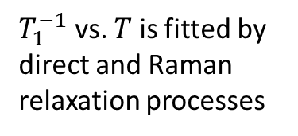
Pulsed EPR Study: Spin-Lattice Relaxation
Echo intensity
Measure T₁ by picket-fence sequence
Pulse delay time
9.5 GHz
$T_{1}^{−1}$ vs. $T$ is fitted by direct and Raman relaxation processes
34 GHz
8

Slide 20
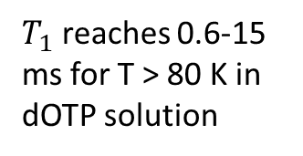
Pulsed EPR Study: Spin-Lattice Relaxation
Echo intensity
Measure T₁ by picket-fence sequence
Pulse delay time
$T_{1}$ reaches 0.6-15 ms for T > 80 K in dOTP solution
9.5 GHz
$T_{1}^{−1}$ vs. $T$ is fitted by direct and Raman relaxation processes
34 GHz
8

Slide 21
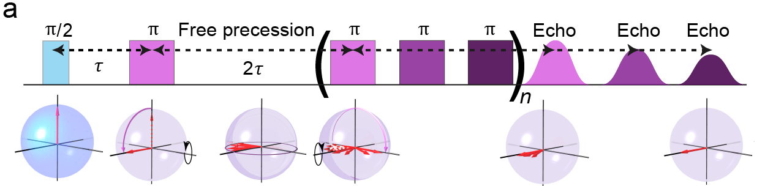
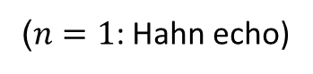
Spin Coherence
Carr-Purcell-Meiboom-Gill (CPMG) sequence
($n=1$: Hahn echo)
9

Slide 22
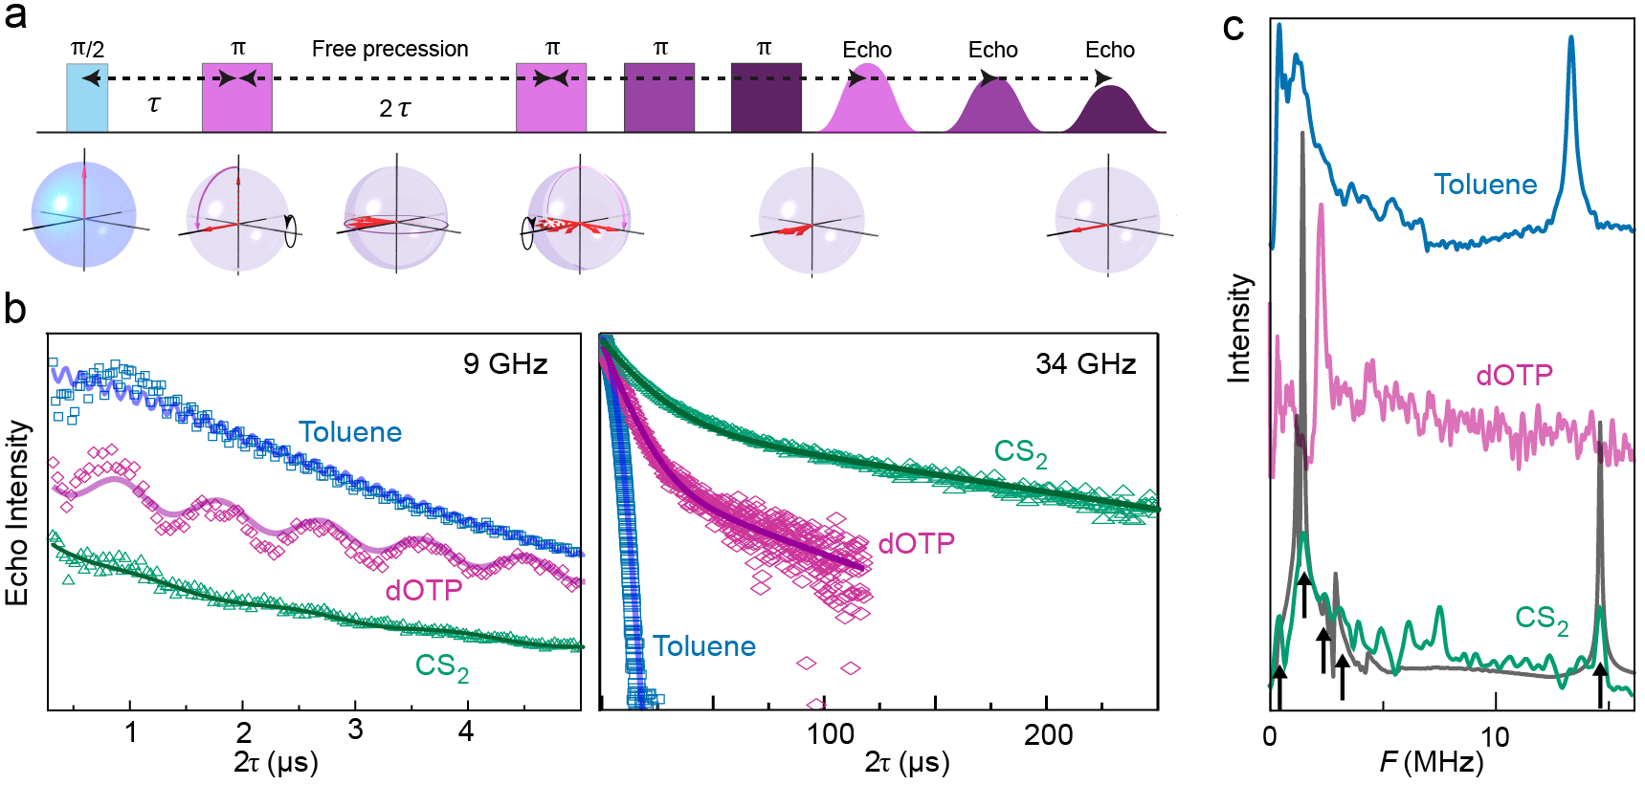
Spin Coherence
Carr-Purcell-Meiboom-Gill (CPMG) sequence
($n=1$: Hahn echo)
Echo decay with nuclear modulation effect
9

Slide 23
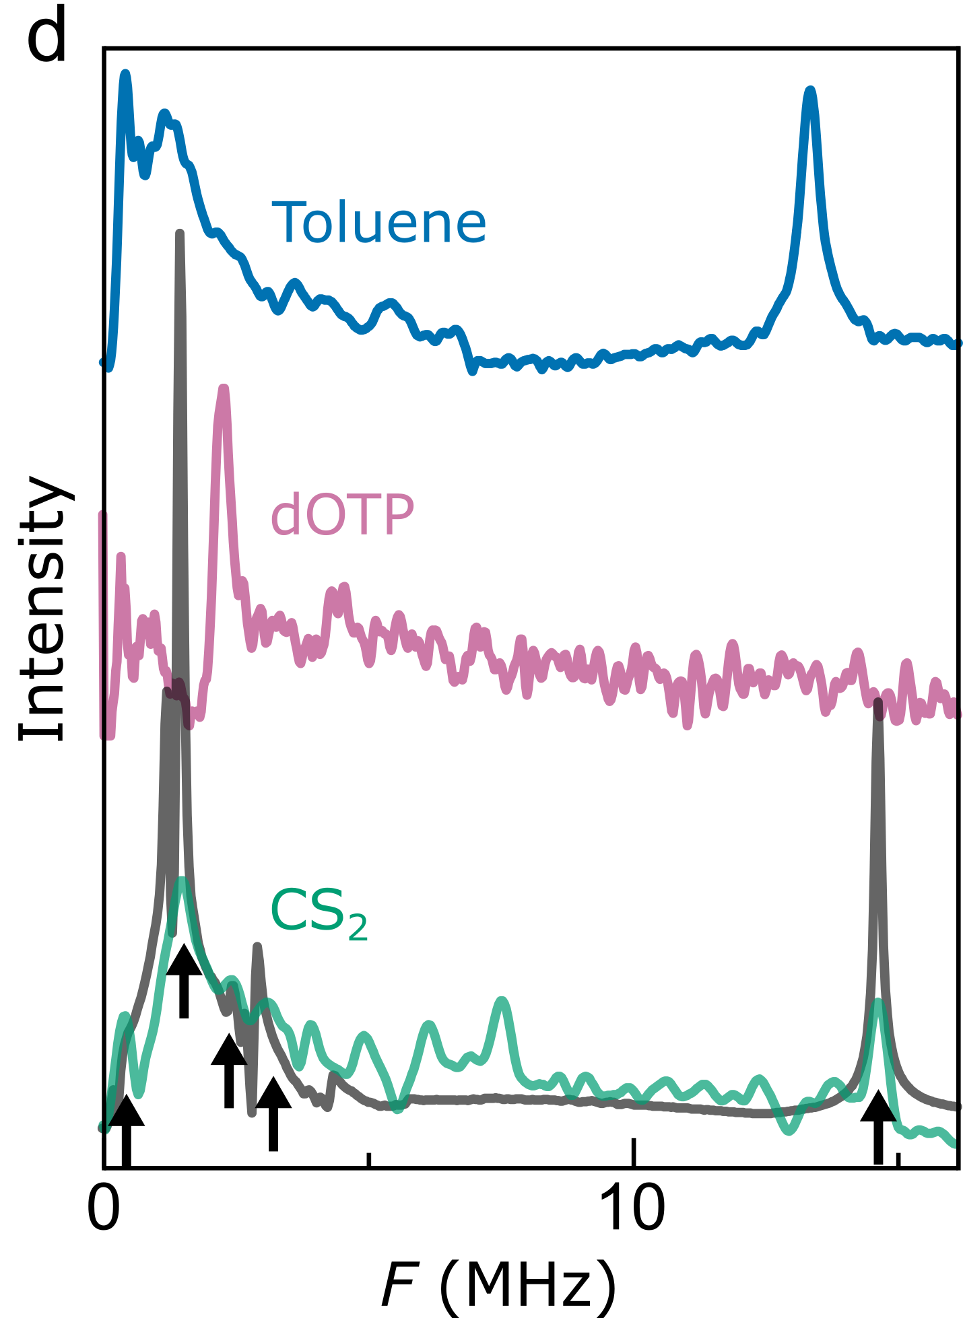
Spin Coherence
Carr-Purcell-Meiboom-Gill (CPMG) sequence
($n=1$: Hahn echo)
Echo decay with nuclear modulation effect
Fourier transform
9
Notes:
Fourier transforms reveal frequencies typical of hydrogen (14-15 MHz), deuterium (2.2 MHz), and chlorine (1.3 MHz)
intrinsic hyperfine of the zigzag segment is dominant

Slide 24
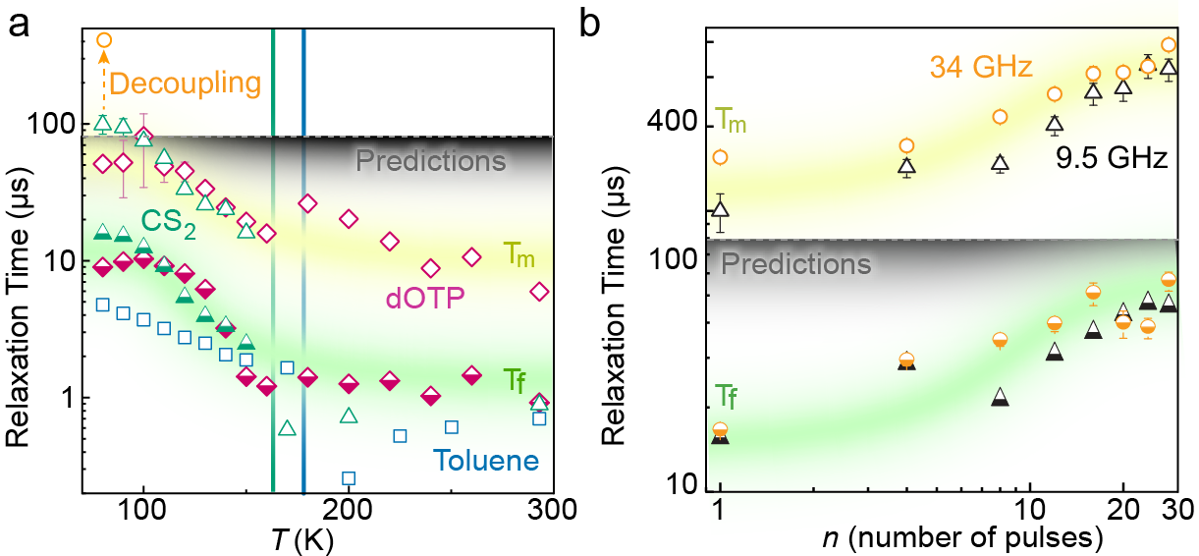
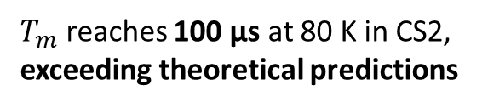
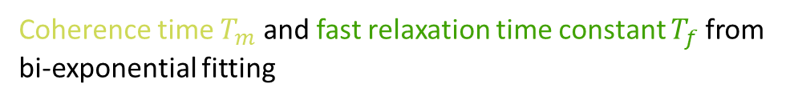
Spin Coherence
Coherence time $T_{m}$ and fast relaxation time constant $T_{f}$from bi-exponential fitting
$T_{m}$ reaches 100 µs at 80 K in CS2, exceeding theoretical predictions
10
Notes:
Here we use the convention: spin memory time

Slide 25
Spin Coherence
Coherence time $T_{m}$ and fast relaxation time constant $T_{f}$from bi-exponential fitting
$T_{m}$ reaches 100 µs at 80 K in CS2, exceeding theoretical predictions
Further increasing coherence time up to 400 µs by dynamical decoupling from the nuclear bath
10
Notes:
intramolecular vibration modes contribute the most to the relaxation

Slide 26
Conclusion
Short zigzag segment in molecular nanographene as a gateway to understand extended systems.
Spin coherence time exceeding theoretical predictions.
More possibilities to build extended graphene nanoribbon systems, which can form quantum spin chain or host topological non-trivial phase.
11
Notes:
Plenty of room to further optimize

Slide 27





Acknowledgements
University of Oxford
Lapo Bogani
Federico Lombardi
Michael Slota
Karen Yan
William Myers
NUS
Yong Ni
Jishan Wu
Notes:
intramolecular vibration modes contribute the most to the relaxation

